Slide 2
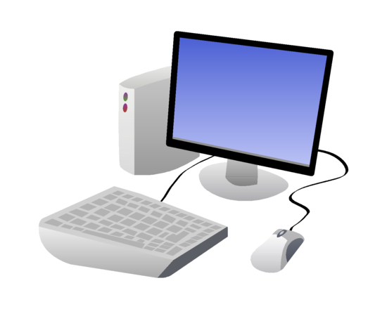
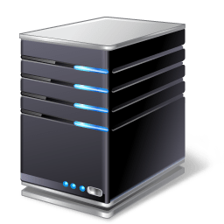
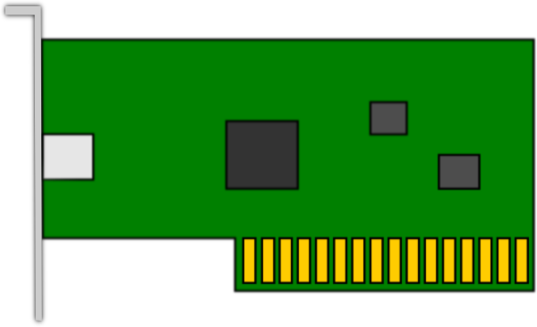
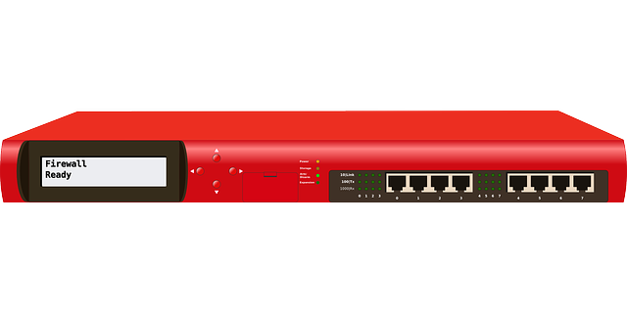
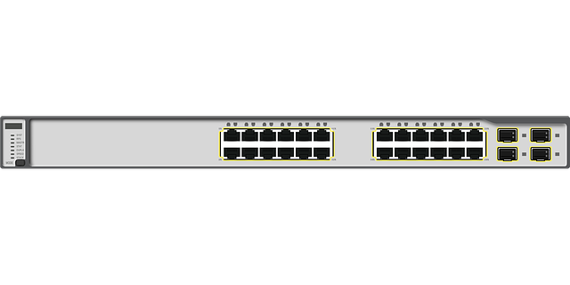
Virtualization
Creating a logical representation of something
Examples
Computers (machines)
Network adapters
Network devices

Slide 3
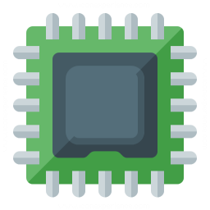
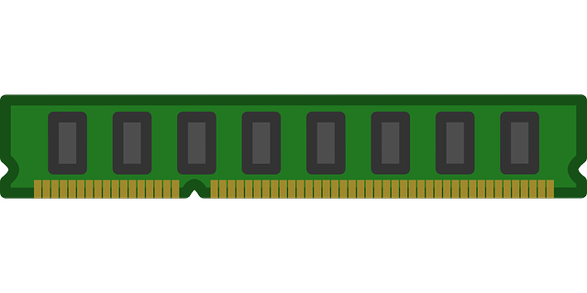
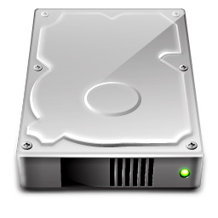
Hosts Machines
Physical device
Controls guests
Allocation of resources
Notes:
Could be Users,
Machines, service accounts fall under the NPE designation

Slide 4
Guest Machines
Virtual machines
Logical representations
Isolated from the host
Function like physical devices
Notes:
Virtual resources used by the guests, allocated through the host machine

Slide 5


Hypervisors
Applications
Virtual Machines
Hypervisor
Host Machine
Notes:
File System Permissions
NTFS Permission
Share Permissions

Slide 6
Type 1 Hypervisor
Applications
Virtual Machines
Hypervisor
Host Machine
Notes:
File System Permissions
NTFS Permission
Share Permissions

Slide 7
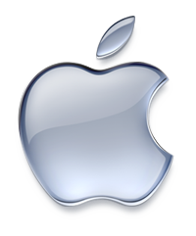
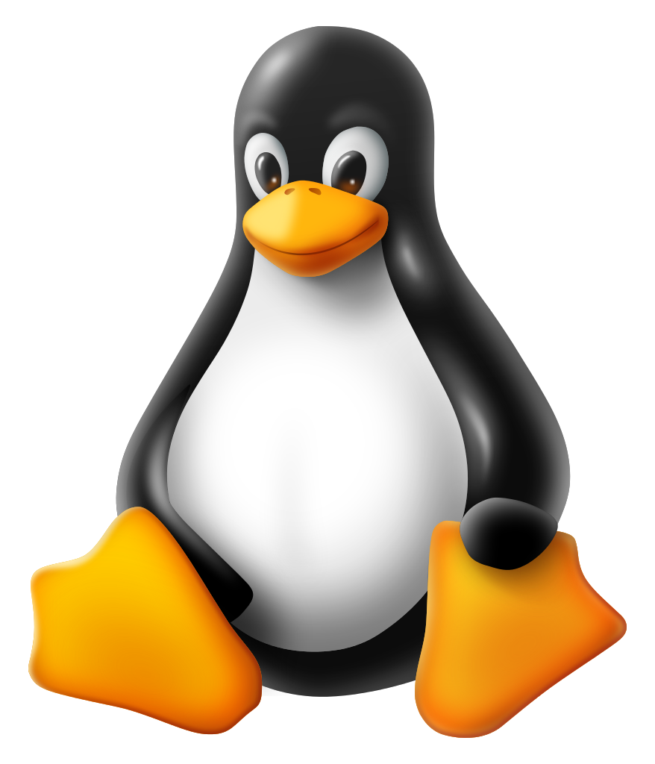
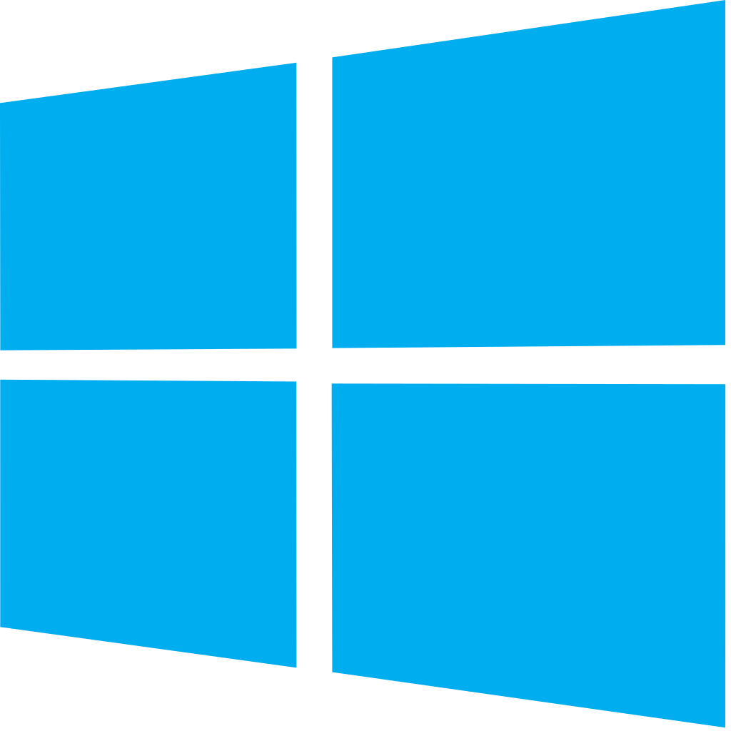
Type 2 Hypervisor
Applications
Virtual Machines
Hypervisor
Operating System
Host Machine
Notes:
File System Permissions
NTFS Permission
Share Permissions

Slide 8
Virtual Network Adapters
Host Machine
Virtual NICs
Host’s physical adapter
Virtual Switch
Guest(VM) 1
Guest(VM) 2
Guest(VM) 3
Guest(VM) 4
Notes:
File System Permissions
NTFS Permission
Share Permissions

Slide 9
Virtual Networking
Host Machine
Virtual Switch
LAN
VM 1
VM 2
VM 3
VM 4
Notes:
File System Permissions
NTFS Permission
Share Permissions

Slide 10



Containers
Host Machine
Virtual Machine

Slide 11
Containers
Container 1
Container 2
Container 3

Slide 12
Container Engines
Docker Hub
Oracle Cloud Infrastructure Compute
Canonical LXD
Amazon Elastic Container Service

Slide 13
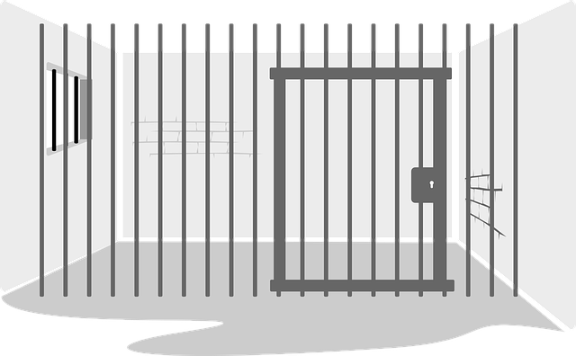



Considerations
Virtualization
Better resource utilization
Multiple software environments
Scalable
Need be secured
Virtual Machines
Isolated software environments
Requires configuration
Need to be secure

Slide 14
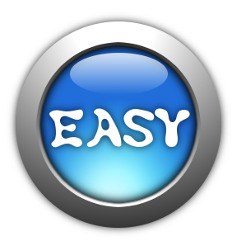




Considerations
Containers
Ease of configuration
Less overhead
Platform independent
Portability

